Slide 1







Stack Overflow Developer Survey 2019
Aman Pahuja
November 26, 2023

Slide 2



OUTLINE
Executive Summary
Introduction
Methodology
Results
Visualization – Charts
Dashboard
Discussion
Findings & Implications
Conclusion
Appendix

Slide 3

EXECUTIVE SUMMARY
Understanding the data context and defining analysis objectives.
Detailing the methodology, encompassing data collection, analysis, and visualization steps.
Presenting results through graphs and identifying trends.
Discussing overarching findings and implications.
Drawing final conclusions based on the research conducted.
Understanding the data context and defining analysis objectives.
Detailing the methodology, encompassing data collection, analysis, and visualization steps.
Presenting results through graphs and identifying trends.
Discussing overarching findings and implications.
Drawing final conclusions based on the research conducted.
Understanding the data context and defining analysis objectives.
Describing methodology * encompassing data collection
* Analyzing the data
* Data visualization
Presenting results through graphs and identifying trends.
Discussing overall findings and implications.
Drawing final conclusions based on the research conducted.

Slide 4

INTRODUCTION
This report delves into a subset of data derived from Stack Overflow's comprehensive Developer Survey.
The survey, with around 90,000 respondents worldwide.
Survey predicts where the developer community stands
Where they are
Where they are heading

Slide 5

METHODOLOGY
Data Collection: Using APIs, Web scraping
Data Wrangling: Removing Duplicates, Normalization, Dealing with Missing Values
Exploratory Data Analysis: Distribution, Outliers, Correlation
Data Visualization: Visualizing Data, Analyzing Relationships, Composition and Comparison
Dashboards

Slide 6

RESULTS

Slide 7
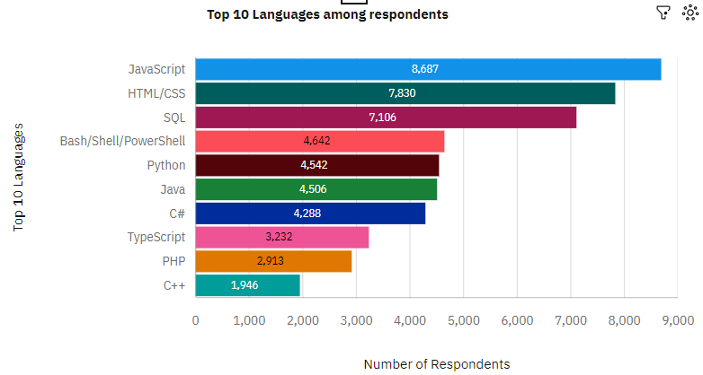
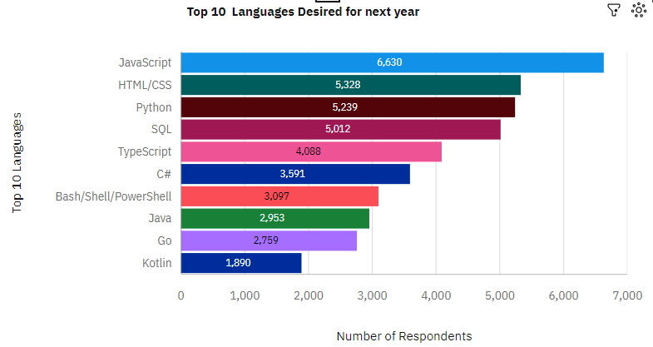
PROGRAMMING LANGUAGE TRENDS
Current Year
Next Year

Slide 8
PROGRAMMING LANGUAGE TRENDS - FINDINGS & IMPLICATIONS
Findings
It is quite clear that JavaScript is most famous.
Python shows consistent growth.
Interest increasing in typescript.
Implications
Developers seems to be migrating from JavaScript and PowerShell l to Typescript, Go and Python

Slide 9
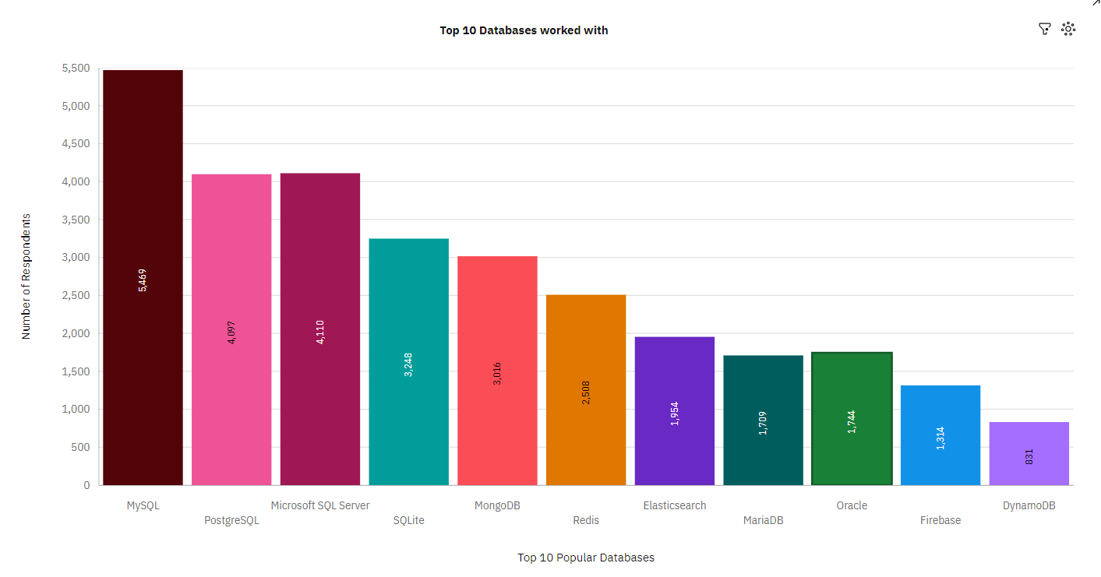
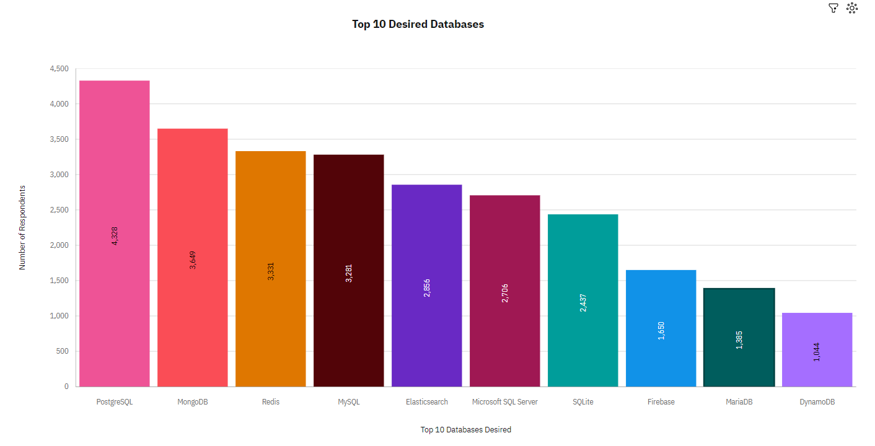
DATABASE TRENDS
Current Year
Next Year

Slide 10
DATABASE TRENDS - FINDINGS & IMPLICATIONS
Findings
MySQL is most famous
Increasing interest in PostgreSQL and MongoDB
Developers are losing interest in Microsoft SQL and SQLite.
Implications
Microsoft SQL Server is losing grounds in market.
The waning interest in Microsoft SQL and SQLite implies a potential shift in developer preferences

Slide 11

DASHBOARD
https://us1.ca.analytics.ibm.com/bi/?perspective=dashboard&pathRef=.my_folders%2FCurrent%2BTechnology%2Busage&action=view&mode=dashboard&subView=model0000018c09b24f46_00000000

Slide 12
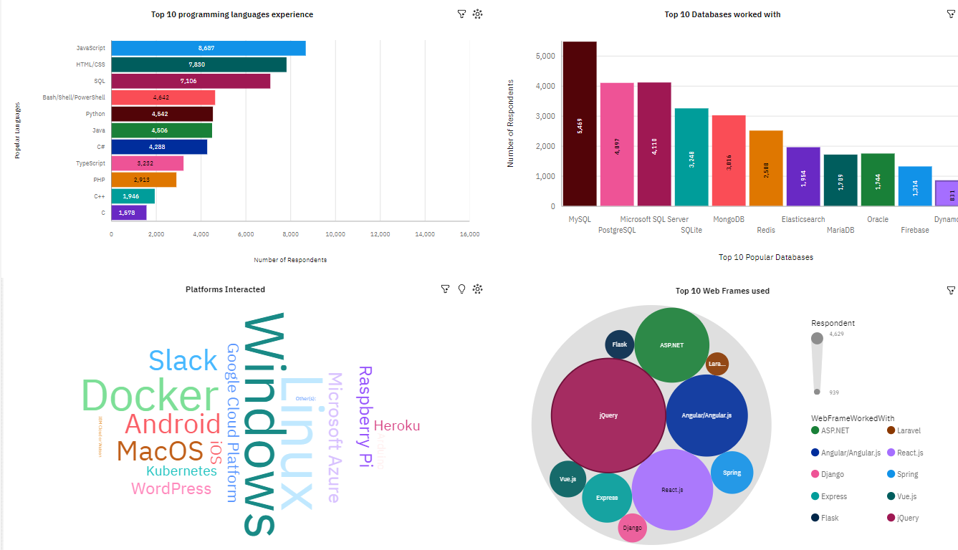
Current Technology usage

Slide 13
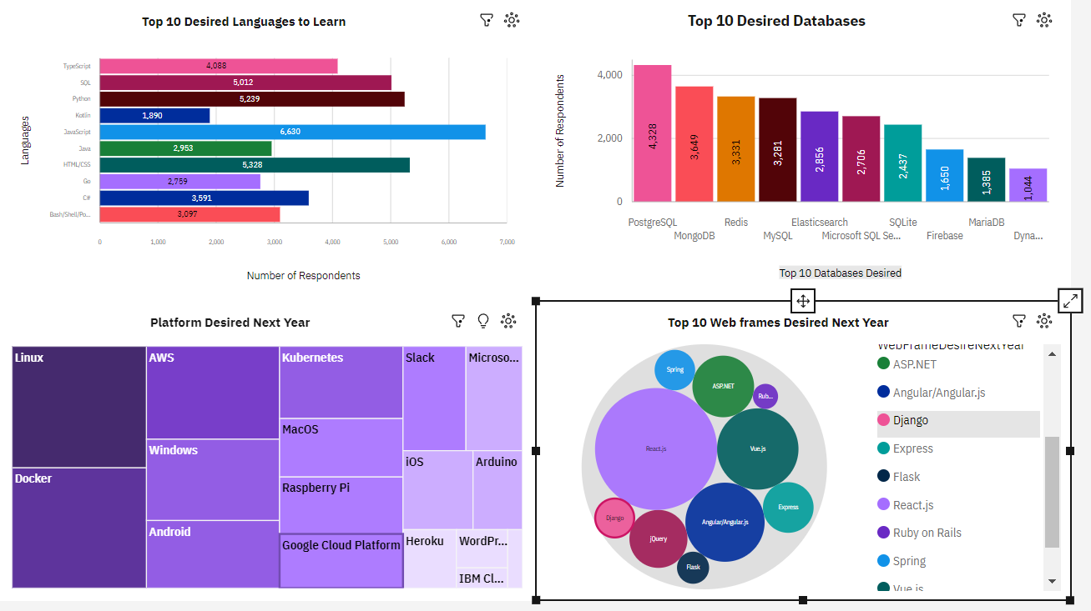
Future Technology Trends

Slide 14
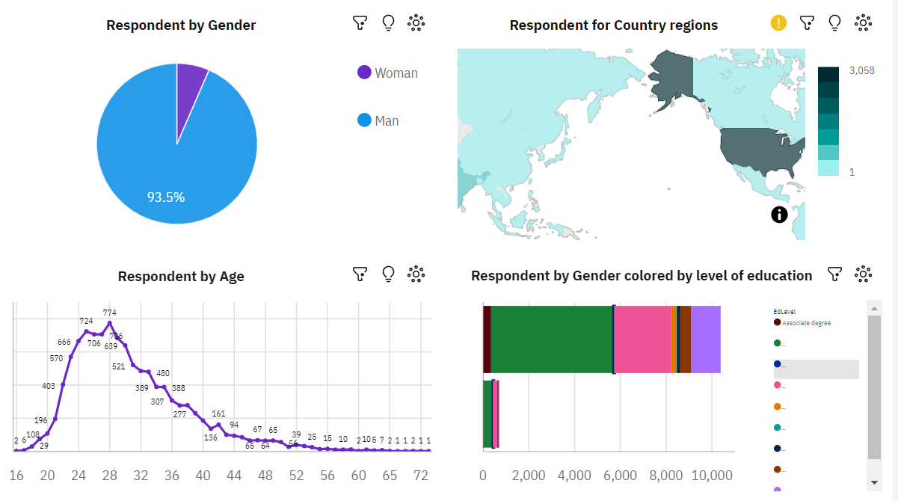
Demographics

Slide 15
DISCUSSION

Slide 16
OVERALL FINDINGS & IMPLICATIONS
Findings
Overall, there are more than 93% of male respondents.
Most of developers prefer working on Windows and Linux OS.
JavaScript is most popular language
Most number of respondents are from US.
Implications
Address gender diversity concerns in the developer community.
Emphasize ongoing support for JavaScript and Python.
Prioritize cross-platform compatibility for Windows and Linux.

Slide 17

CONCLUSION
Developers exhibit distinct characteristics.
Trends in tool, platform, and language popularity are discernible.
Efforts needed to extend job opportunities in the tech industry to developing countries.

Slide 18
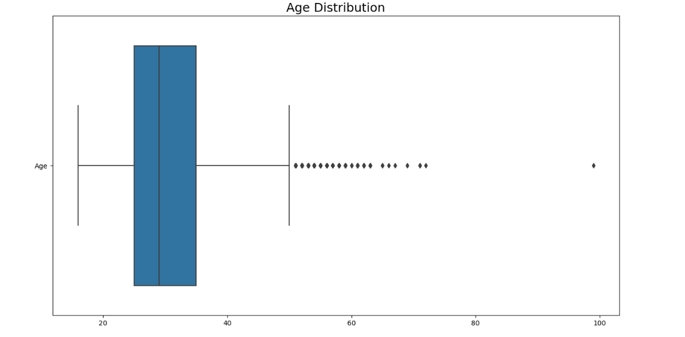
APPENDIX

Slide 19
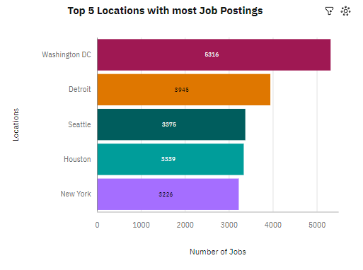
JOB POSTINGS

Slide 20
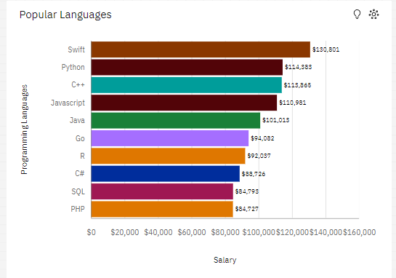
POPULAR LANGUAGES

